Slide 1
Chapter 5
Gases

Slide 2
5.1 Pressure
5.2 The Gas Laws of Boyle, Charles, and Avogadro
5.3 The Ideal Gas Law
5.4 Gas Stoichiometry
5.5 Dalton’s Law of Partial Pressures
5.6 The Kinetic Molecular Theory of Gases
5.7 Effusion and Diffusion
5.8 Real Gases
5.9 Characteristics of Several Real Gases
5.10 Chemistry in the Atmosphere

Slide 3
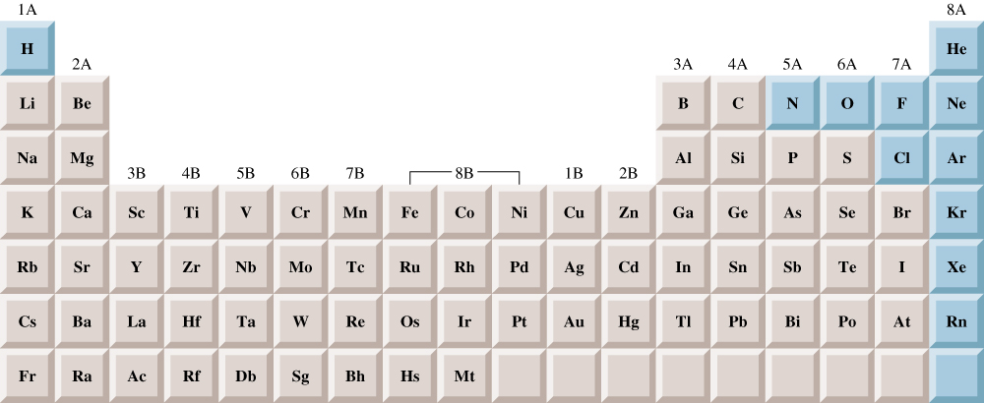
Elements that exist as gases at 25 deg C and 1 atmosphere
5.1

Slide 4
A Gas
Uniformly fills any container.
Mixes completely with any other gas.
Exerts pressure on its surroundings.

Slide 5
Pressure
SI units = Newton/meter² = 1 Pascal (Pa)
1 standard atmosphere = 101,325 Pa
1 standard atmosphere = 1 atm =
760 mm Hg = 760 torr

Slide 6
Barometer
Device used to measure atmospheric pressure.
Mercury flows out of the tube until the pressure of the column of mercury standing on the surface of the mercury in the dish is equal to the pressure of the air on the rest of the surface of the mercury in the dish.

Slide 7
Manometer
Device used for measuring the pressure of a gas in a container.

Slide 8
Liquid Nitrogen and a Balloon

Slide 9
Boyle’s Law
Pressure and volume are inversely related (constant T, temperature, and n, # of moles of gas).
PV = k (k is a constant for a given sample of air at a specific temperature)

Slide 10
Boyle’s Law

Slide 11
Charles’s Law
Volume and Temperature (in Kelvin) are directly related (constant P and n).
V=bT (b is a proportionality constant)
K = °C + 273
0 K is called absolute zero.

Slide 12
Charles’s Law

Slide 13
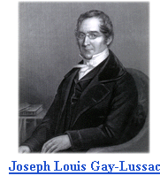
Gay-Lussac’s Law
If n and V are constant,
then P α T
P and T are directly proportional.
P₁ P₂
₌
T₁ T₂
If one temperature goes up, the pressure goes up!
Joseph Louis Gay-Lussac (1778-1850)

Slide 14

Combined Gas Law
The good news is that you don’t have to remember all three gas laws! Since they are all related to each other, we can combine them into a single equation. BE SURE YOU KNOW THIS EQUATION!
P₁ V₁ P₂ V₂
=
T₁ T₂
No, it’s not related to R2D2

Slide 15

Exercise
At what temperature (in °C) does 121 mL of CO₂ at 27°C and 1.05 atm occupy a volume of 293 mL at a pressure of 1.40 atm?
696°C
Notes:
The new temperature is 696°C.
(1.05 atm)(121 mL) / (27+273) = (1.40 atm)(293 mL) / (T₂ + 273)

Slide 16


And now, we pause for this commercial message from STP
OK, so it’s really not THIS kind of STP…
STP in chemistry stands for Standard Temperature and Pressure
Standard Pressure =
1 atm
(or an equivalent)
Standard Temperature = 0 deg C (273 K)
STP allows us to compare amounts of gases between different pressures and temperatures

Slide 17
Avogadro’s Law
Volume and number of moles are directly related (constant T and P).
V = an (a is a proportionality constant)

Slide 18
We can bring all of these laws together into one comprehensive law:
        V = bT (constant P and n)
        V = an (constant T and P)
        V = (constant T and n)
        PV = nRT
        (where R = 0.08206 L·atm/mol·K, the universal gas constant)

Slide 19
Exercise
An automobile tire at 23°C with an internal volume of 25.0 L is filled with air to a total pressure of 3.18 atm. Determine the number of moles of air in the tire.
3.27 mol
Notes:
The number of moles of air is 3.27 mol.
(3.18 atm)(25.0 L) = n(0.08206)(23+273)

Slide 20
A 2.10-L vessel contains 4.65 g of a gas at 1.00 atm and 27.00C. What is the molar mass of the gas?
PV = nRT
2.10 L
X 1 atm
n =
L•atm
0.0821 x 300.15 K
mol•K
n = 0.0852 mol
g
M =
54.6 g/mol
n =
M
5.3

Slide 21
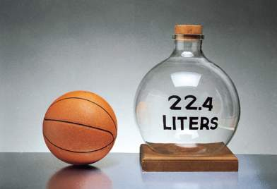
Molar Volume of an Ideal Gas
For 1 mole of an ideal gas at 0°C and 1 atm, the volume of the gas is 22.4 L.
STP = standard temperature and pressure
  0°C and 1 atm
  Therefore, the molar volume is 22.4 L at STP.

Slide 22
Molar Mass of a Gas
        d = density of gas
        T = temperature in Kelvin
        P = pressure of gas
        R = universal gas constant

Slide 23
Exercise
What is the density of F₂ at STP (in g/L)?
1.70 g/L
Notes:
d = (MM)(P) / (R)(T)
d = (19.00g/mol × 2)(1.00 atm) / (0.08206)(273 K)
d = 1.70 g/L

Slide 24
For a mixture of gases in a container,
P_{Total} = P₁ + P₂ + P₃ + . . .
The total pressure exerted is the sum of the pressures that each gas would exert if it were alone.

Slide 25
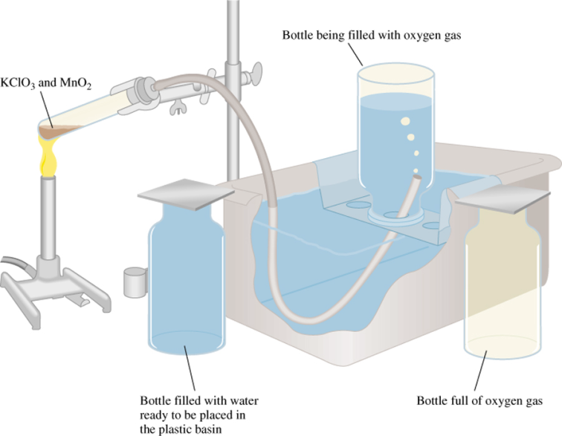
Bottle full of oxygen gas and water vapor
2KClO₃ (s) 2KCl (s) + 3O₂ (g)
P_{T} = P_{O} + P_{H O}
2
2
5.6

Slide 26
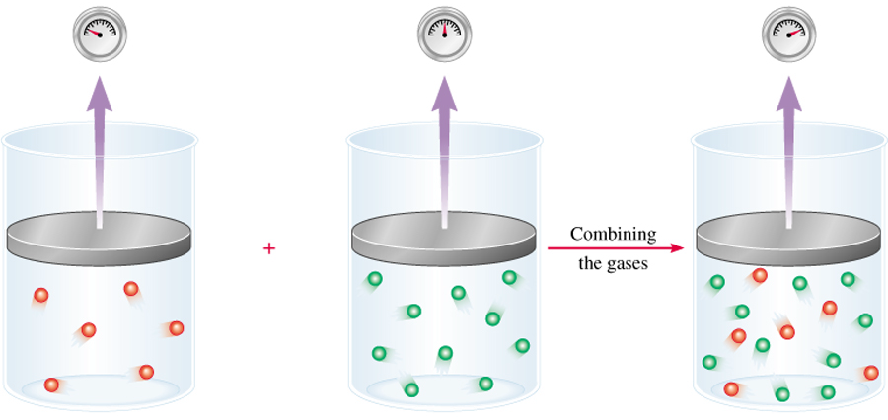
Dalton’s Law of Partial Pressures
V and T are constant
P₁
P₂
P_{total} = P₁ + P₂
5.6

Slide 27

Consider a case in which two gases, A and B, are in a container of volume V.
n_{A}RT
P_{A} =
n_{A} is the number of moles of A
V
n_{B}RT
P_{B} =
n_{B} is the number of moles of B
V
n_{A}
n_{B}
P_{T} = P_{A} + P_{B}
X_{A} =
X_{B} =
n_{A} + n_{B}
n_{A} + n_{B}
P_{A} = X_{A} P_{T}
P_{B} = X_{B} P_{T}
P_{i} = X_{i} P_{T}
n_{i}
mole fraction (X_{i}) =
n_{T}
5.6

Slide 28
A sample of natural gas contains 8.24 moles of CH₄, 0.421 moles of C₂H₆, and 0.116 moles of C₃H₈. If the total pressure of the gases is 1.37 atm, what is the partial pressure of propane (C₃H₈)?
P_{i} = X_{i} P_{T}
P_{T} = 1.37 atm
0.116
X_{propane} =
= 0.0132
8.24 + 0.421 + 0.116
P_{propane} = 0.0132 x 1.37 atm
= 0.0181 atm
5.6

Slide 29
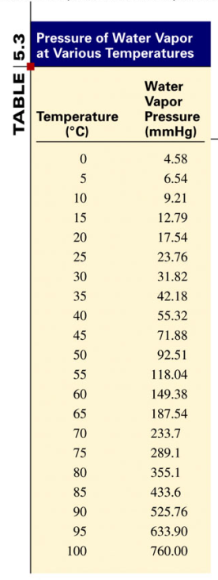
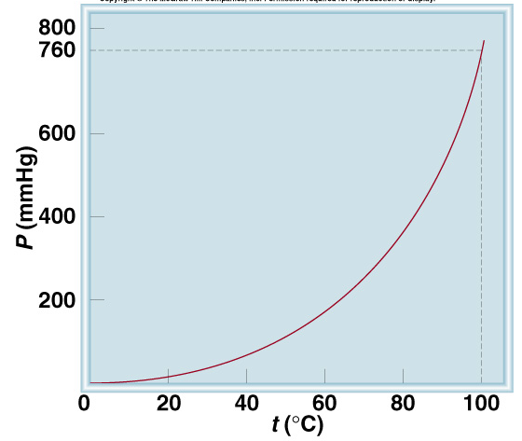
5.6

Slide 30
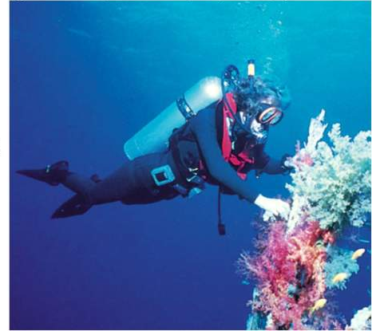
Chemistry in Action:
Scuba Diving and the Gas Laws
Depth (ft) | Pressure (atm)
0 | 1
33 | 2
66 | 3
P
V
5.6

Slide 31
Postulates of the Kinetic Molecular Theory
1) The particles are so small compared with the distances between them that the volume of the individual particles can be assumed to be negligible (zero).

Slide 32
Postulates of the Kinetic Molecular Theory
2) The particles are in constant motion. The collisions of the particles with the walls of the container are the cause of the pressure exerted by the gas.

Slide 33
Kinetic Molecular Theory

Slide 34
Postulates of the Kinetic Molecular Theory
3) The particles are assumed to exert no forces on each other; they are assumed neither to attract nor to repel each other.

Slide 35
Postulates of the Kinetic Molecular Theory
4) The average kinetic energy of a collection of gas particles is assumed to be directly proportional to the Kelvin temperature of the gas.

Slide 36
Kinetic Molecular Theory

Slide 37
Molecular View of Boyle’s Law

Slide 38
Molecular View of Charles’s Law

Slide 39
Molecular View of The Ideal Gas Law

Slide 40

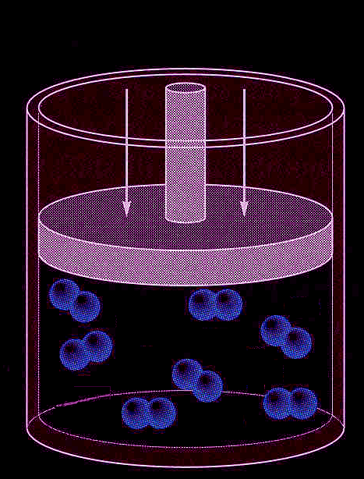
Concept Check
You have a sample of nitrogen gas (N₂) in a container fitted with a piston that maintains a pressure of 6.00 atm. Initially, the gas is at 45°C in a volume of 6.00 L.
You then cool the gas sample.

Slide 41
Concept Check
Which best explains the final result that occurs once the gas sample has cooled?
  The pressure of the gas increases.
  The volume of the gas increases.
  The pressure of the gas decreases.
  The volume of the gas decreases.
  Both volume and pressure change.
Notes:
d) is correct.

Slide 42
Root Mean Square Velocity
R = 8.3145 J/K·mol
(J = joule = kg·m²/s²)
T = temperature of gas (in K)
M = molar mass of gas in kg/mol
Final units are in m/s.

Slide 43
Diffusion – the mixing of gases.
Effusion – describes the passage of a gas through a tiny orifice into an evacuated chamber.
Rate of effusion measures the speed at which the gas is transferred into the chamber.

Slide 44
Effusion

Slide 45
Diffusion

Slide 46
Graham’s Law of Effusion
M₁ and M₂ represent the molar masses of the gases.

Slide 47
We must correct for non-ideal gas behavior when:
  Pressure of the gas is high.
  Temperature is low.
Under these conditions:
  Concentration of gas particles is high.
  Attractive forces become important.

Slide 48
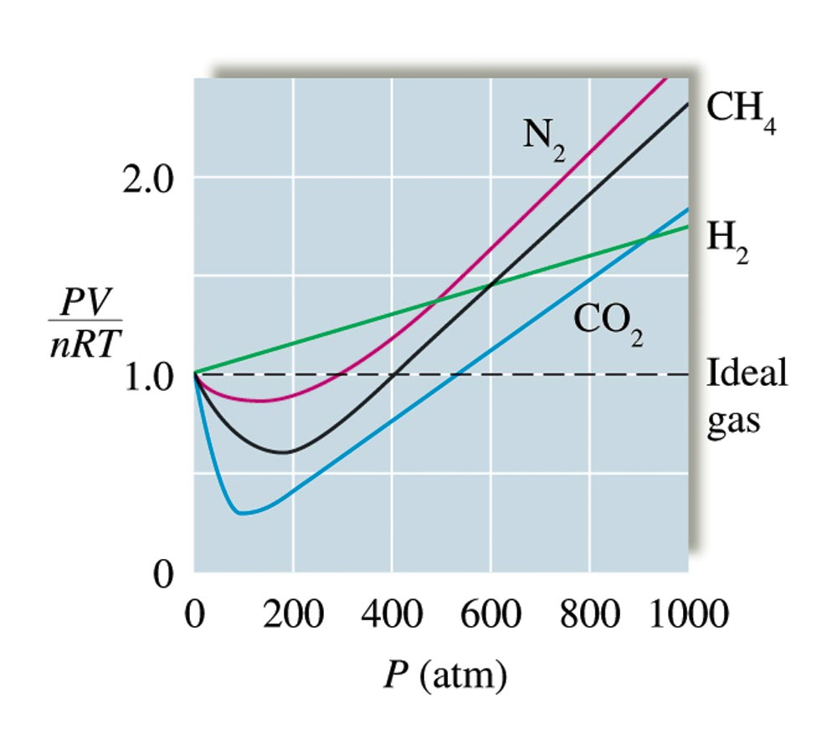
Plots of PV/nRT Versus P for Several Gases (200 K)

Slide 49
Real Gases (van der Waals Equation)
↑
↑
corrected pressure
corrected volume
P_{ideal}
V_{ideal}
You do NOT have to calculate this for AP Chemistry!!!

Slide 50
For a real gas, the actual observed pressure is lower than the pressure expected for an ideal gas due to the intermolecular attractions that occur in real gases.
The total occupied volume difference is due to the space consumed by the atoms/molecules themselves

Slide 51
Air Pollution
Two main sources:
  Transportation
  Production of electricity
Combustion of petroleum produces CO, CO₂, NO, and NO₂, along with unburned molecules from petroleum.

Slide 52
Nitrogen Oxides (Due to Cars and Trucks)
At high temperatures, N₂ and O₂ react to form NO, which oxidizes to NO₂.
The NO₂ breaks up into nitric oxide and free oxygen atoms.
Oxygen atoms combine with O₂ to form ozone (O₃).

Slide 53
Sulfur Oxides (Due to Burning Coal for Electricity)
Sulfur produces SO₂ when burned.
SO₂ oxidizes into SO₃, which combines with water droplets in the air to form sulfuric acid.

Slide 54
Sulfur Oxides (Due to Burning Coal for Electricity)
Sulfuric acid is very corrosive and produces acid rain.
Use of a scrubber removes SO₂ from the exhaust gas when burning coal.

Slide 55
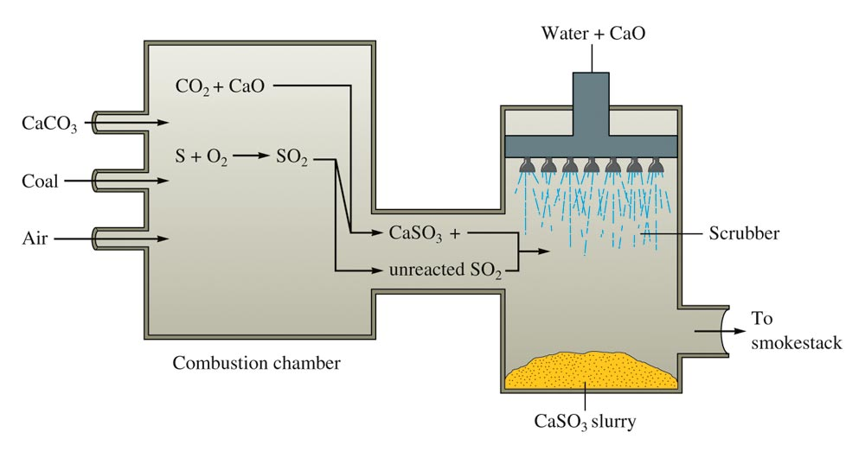
A Schematic Diagram of a Scrubber

Slide 56
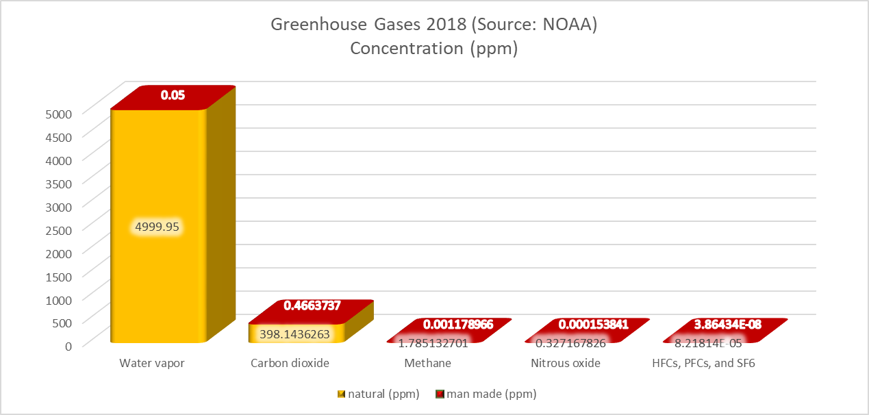
Greenhouse Gases

